Slide 1
Approaches for MSMQ Replacement on Azure

Slide 2
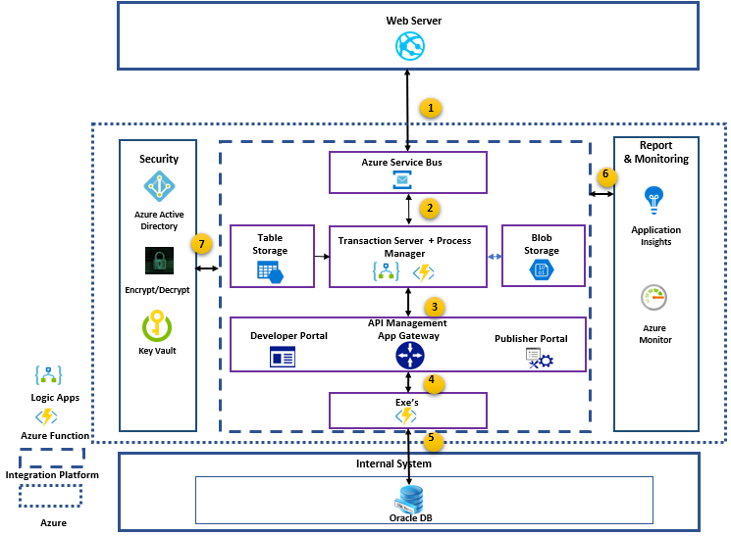
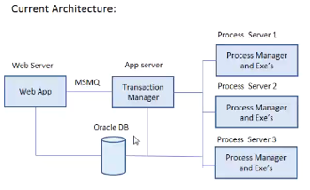
Complete Cloud Migration Solution
Any source system that support http/https protocol send the message to Azure Service Bus
Azure Service Bus will trigger the message to Transaction/Process Manager.
Transactional/Process Server will validate and encode the message using Azure Function and Logic Apps.
Use Configuration files stored in table storage.
Use Blob storage for any custom log management
Call API Management(APIM) endpoints (Azure Functions API’s). APIM integrate with App gateway, which manages load balancing.
Oracle DB, master data used for process manager moved to table storage. Rest it work as it is.
Azure Monitor, Log Analytics will help to monitor entire platform.
2

Slide 3
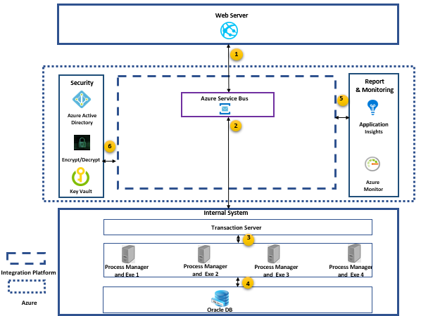
Phase 1
Any source system that support http/https protocol send the message to Azure Service Bus
Azure Service Bus will trigger the message to Transactional Server. Transactional Server work as it is.
Process manager also work as it is.
Oracle DB also work as it is
Azure Monitor, Log Analytics will help to monitor entire platform.
3

Slide 4
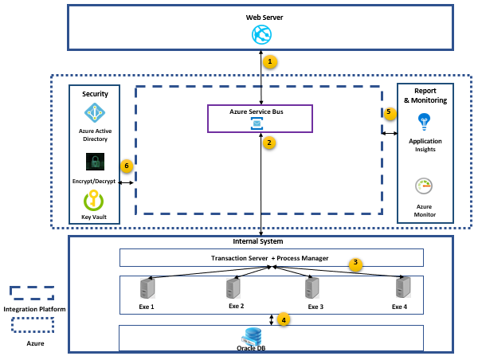
Phase 2
Any source system that support http/https protocol send the message to Azure Service Bus
Azure Service Bus will trigger the message to on- premises Transactional Server.
Process manager code moves to transactional manager (code for load balancing done here)
Oracle DB work as it is.
Azure Monitor, Log Analytics will help to monitor entire platform.
4

Slide 5
Thank You

